Slide 1


The Eye-Writer AN INTERACTION DEVICE FOR DISABLED PERSON
Prepared by
Jigar mangukiya – 120110107027
Vishwa Gandhi – 120110107019
Guided BY
Dr. maulika s. patel
Head – department of computer engineering
G h patel college of engineering & Technology

Slide 2
What’s Included?
Problem & Possible solution
Hardware Assembly
User Interface
MATLAB Implementation
Results
Social Impact
Future work

Slide 3
Problem
Problems faced by a person who has Neuromuscular paralysis
Zero interaction capacity – Cannot express anything with words or hand signs because of paralysis
Total dependency – Fully dependent on external entities for even simplest routine tasks

Slide 4
Potential solution – EyeWriter
Eye Writer is a device that captures the movement of Iris to manipulate entities on a digital display i. e. Computer Screens, Tablets, Smartphones etc.
Utilize their ability to move their eyes to help them navigate the cursor on screen.
Track the movement of the eye using a camera mounted on a spectacle frame.
Select the letters from an on screen keyboard digital key board

Slide 5
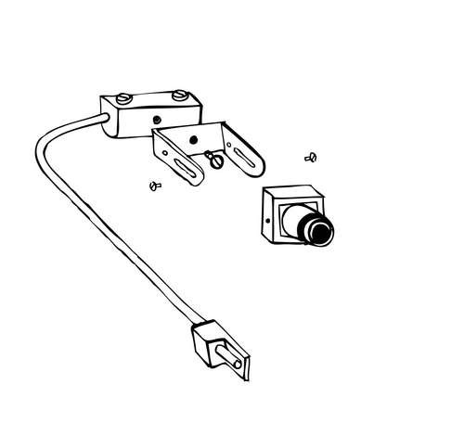
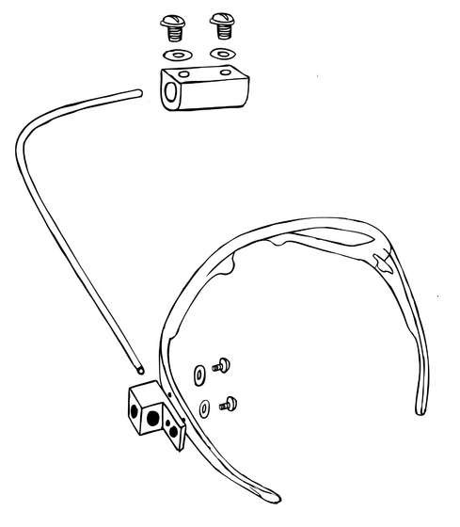
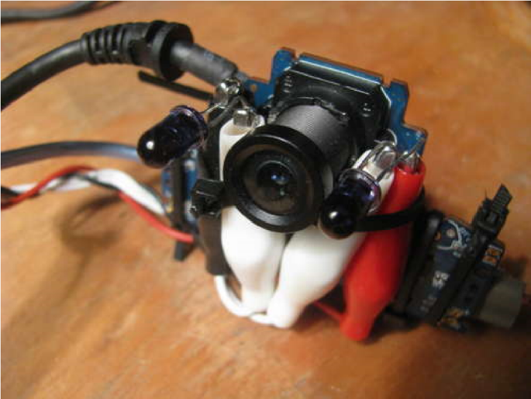
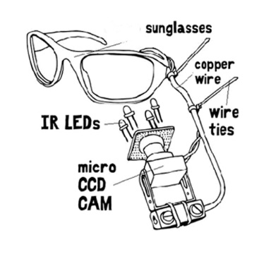
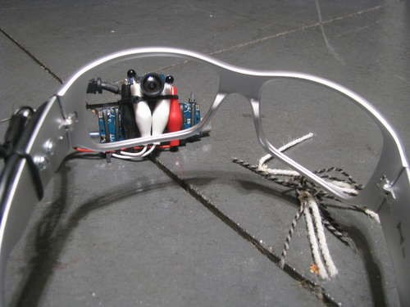
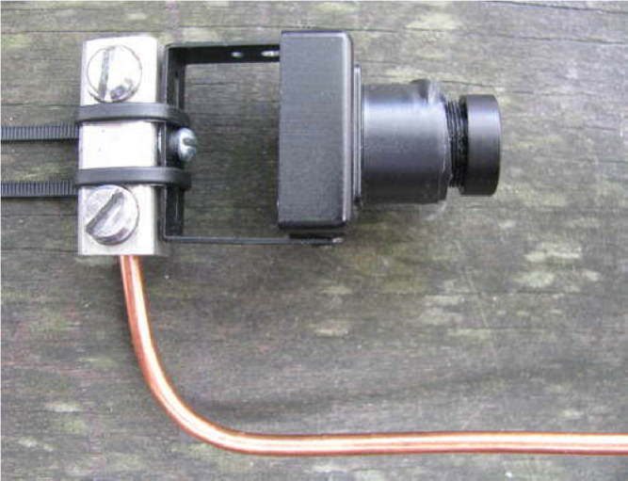
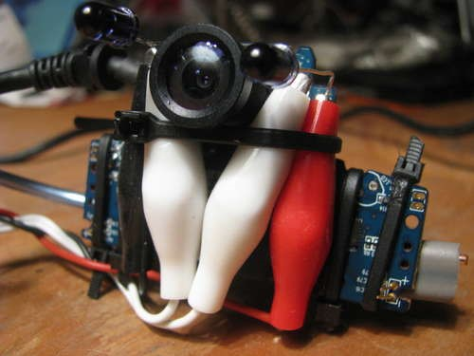
Introduction – The EyeWriter
Structural diagram
The developed prototype
Camera mounted on a spectacle frame with an adjustable light source
A real time image processing engine
A user friendly GUI (Audiovisual Output )

Slide 6
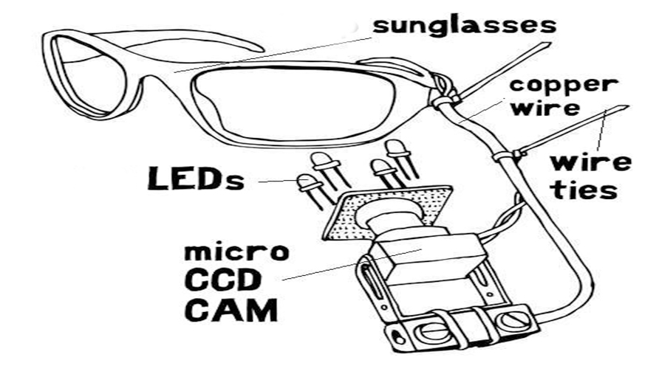
Schematic diagram

Slide 7
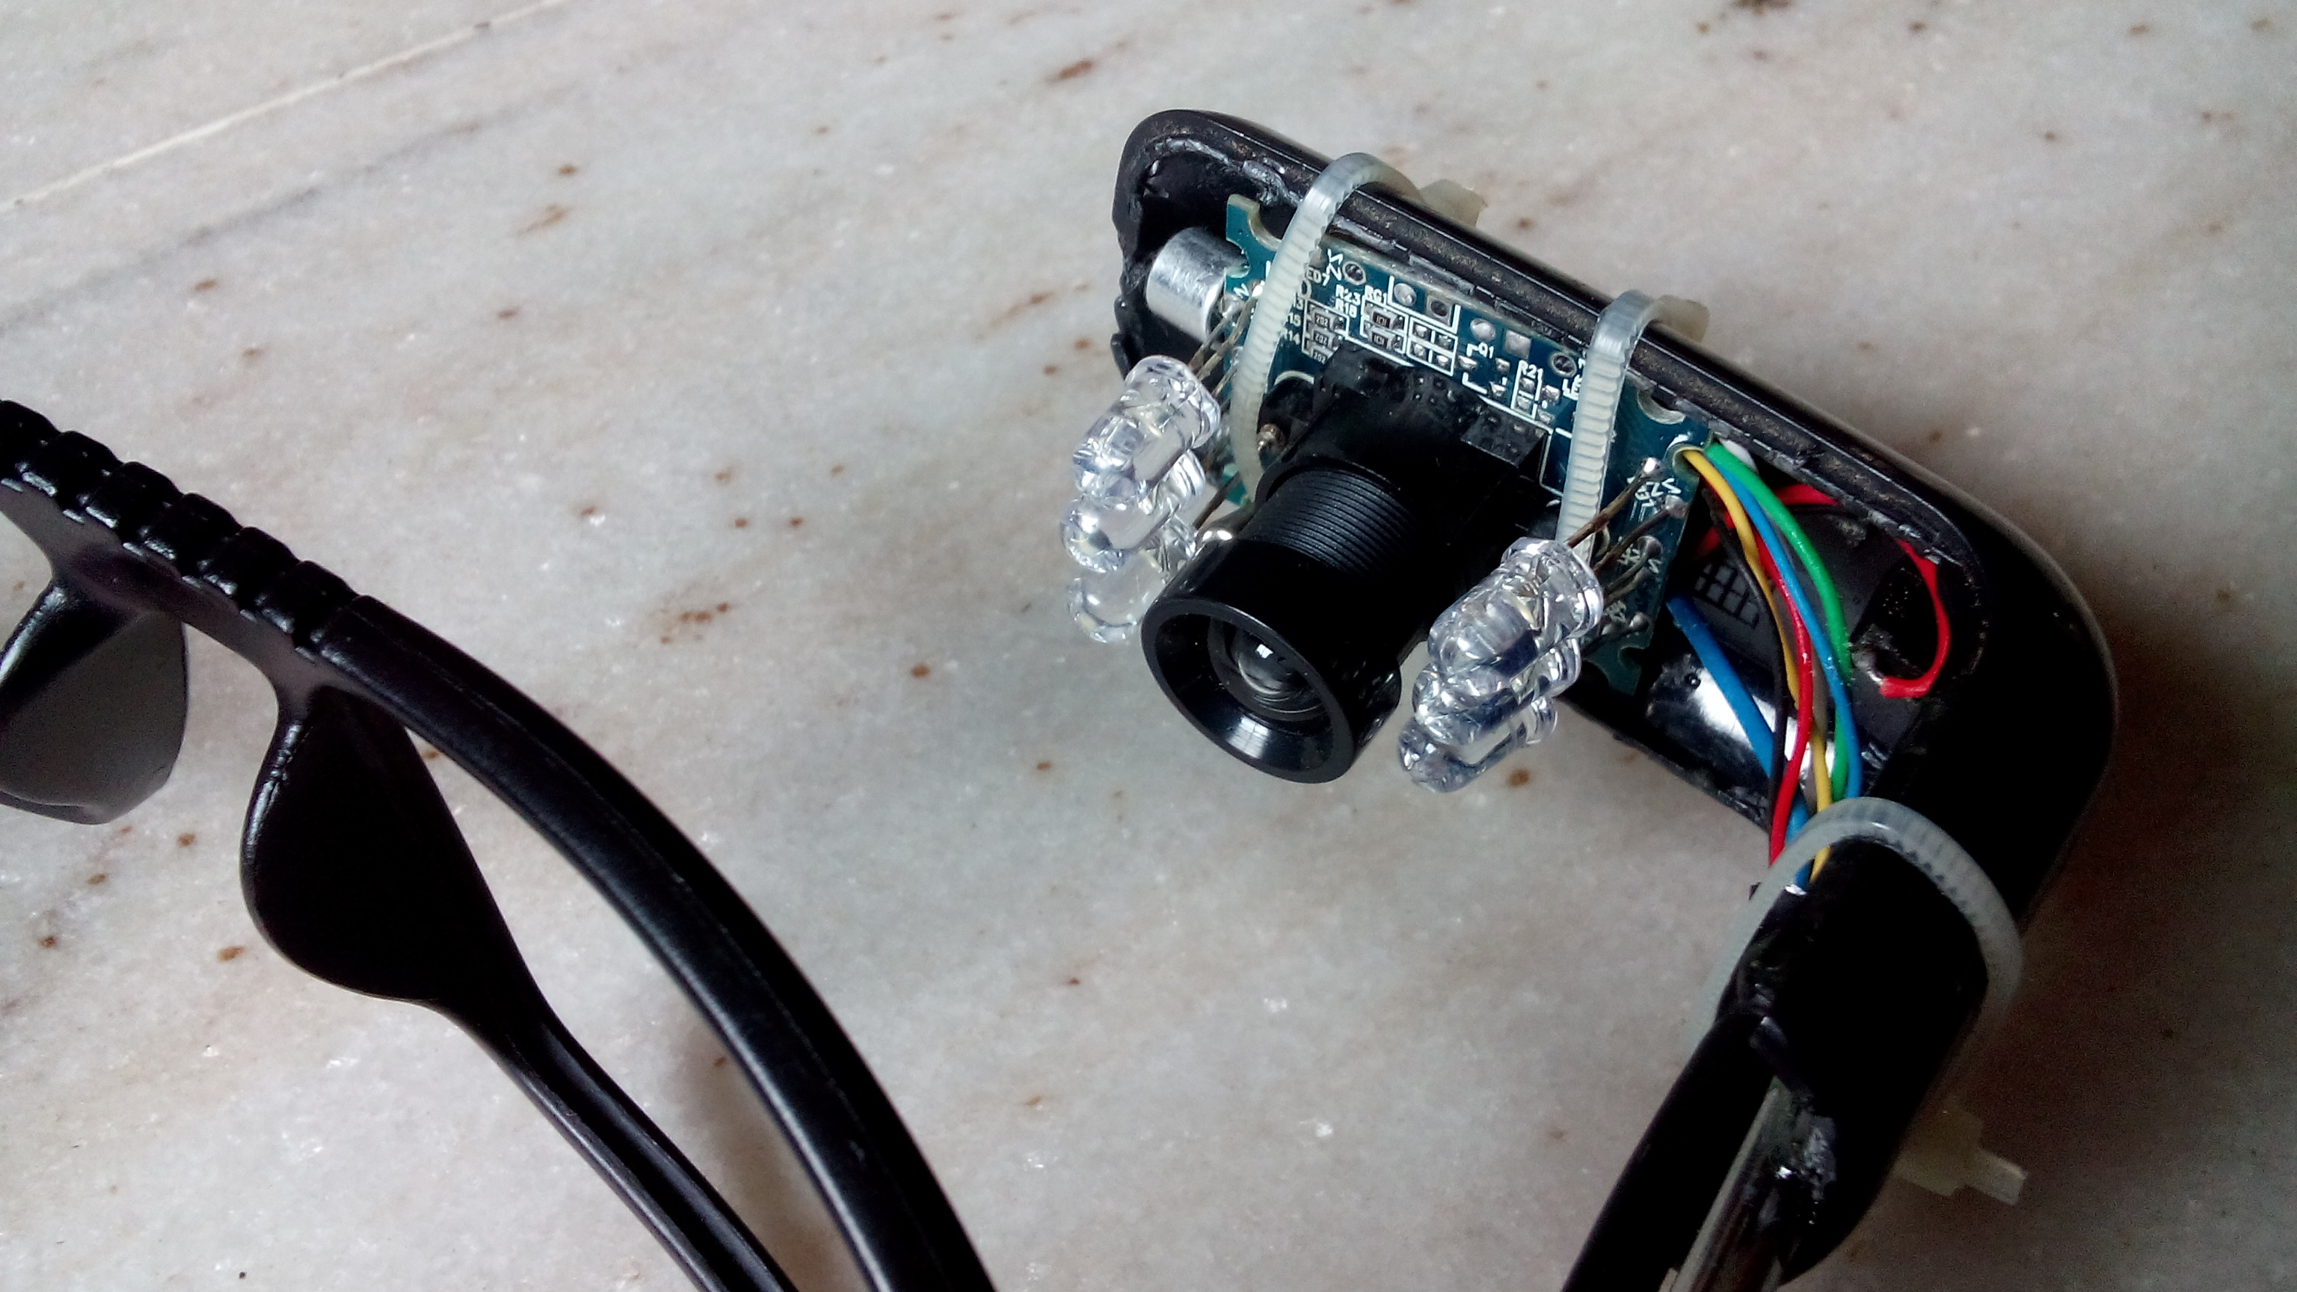
Developed Prototype

Slide 8
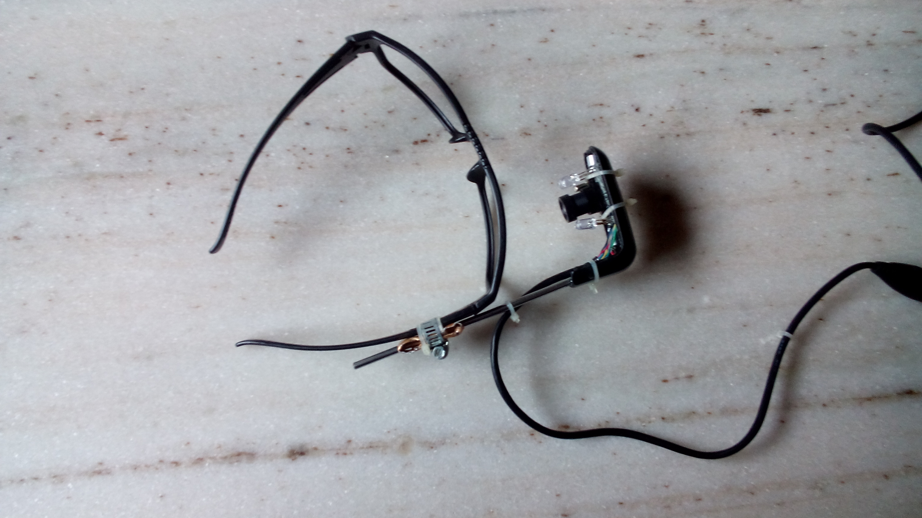

Slide 9
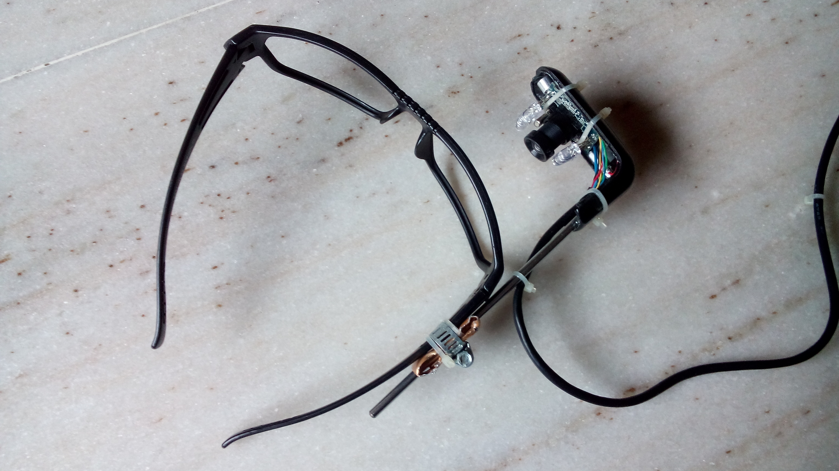

Slide 10
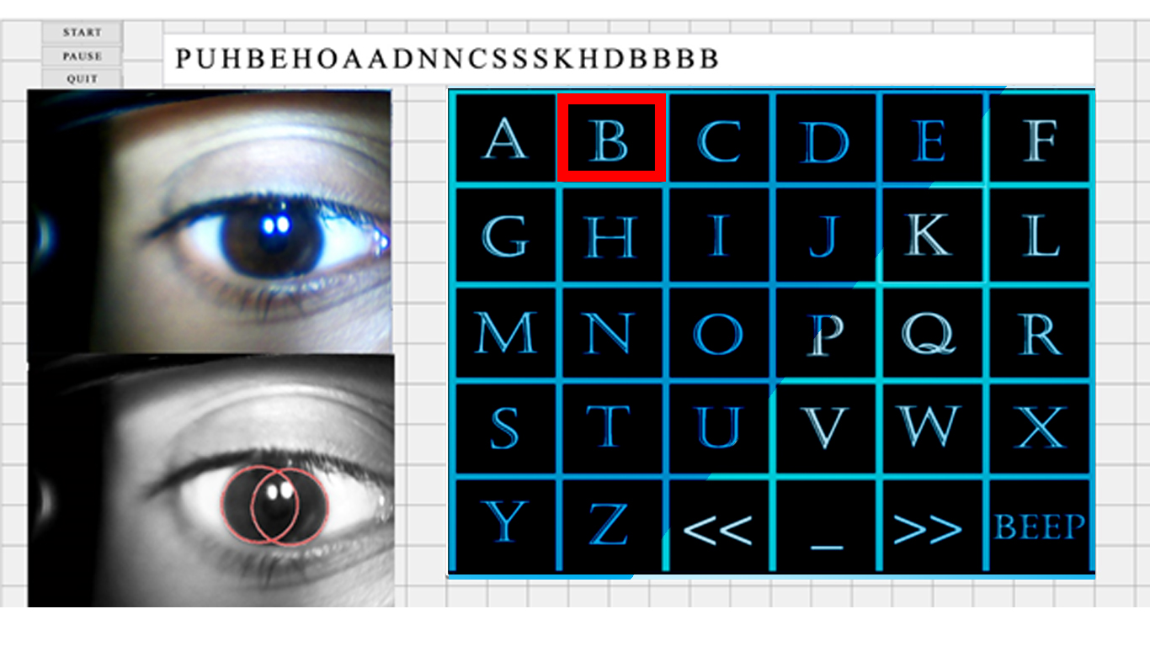
User Interface
Letter pointed by current iris’ center coordinates
Typed Letters are printed here
Control Buttons
Input Video
Processed Video (First Phase)
Detected Circle

Slide 11
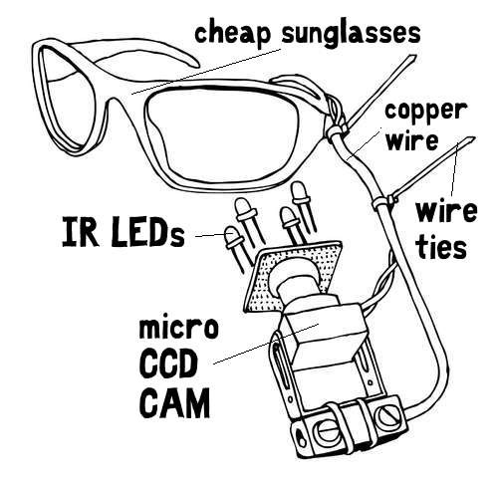
Hardware Assembly
A USB micro cam : 640 * 480 px resolution, 30 FPS, infrared filter removed
Lens mount (10 mm)
A neopixel adjustable voltage artificial light source
Camera mount and a spectacle frame

Slide 12
MATLAB Implementation
A customized lightweight version of predefined algorithm which tracks the coordinates of the center of pupil.
Supports Real Time processing of video at 25-30 FPS
Algorithm Finds Circles best fulfilling the input criteria.
A User friendly GUI that helps a paralyzed person to adept it quickly

Slide 13
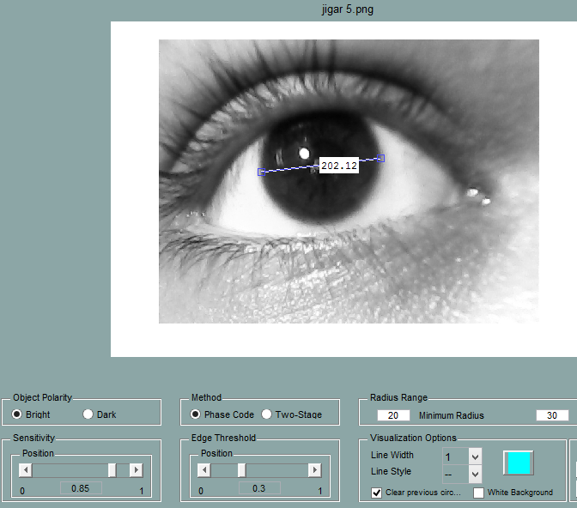
Estimating tolerance parameters
Everybody has different Eye Signatures
With different pupil size
Different Pupil color
Bounds of movement etc.
So some adjustment parameters
are required for algorithm to work universally
Which are,
Edge sensitivity
Image polarity
Estimated radius range
These parameters are measured using Circle Finder GUI

Slide 14
Social Impact
A person who can not say a word or lift a finger has a million hurdles in fulfilling even the most simplest of the needs, like
He has to wait for the scheduled time to have a glass of water
He can not indicate if and where he is having some kind of pain in his body.

Slide 15
Social Impact …. (Cont.)
Eye Writer can let a such person express himself
By typing a letter at a time, slowly but surely he can say what he intends to.
He can draw using his eye movement on a digital canvas, which is a big thing for someone who haven’t moved a finger for months or years.

Slide 16
Social Impact …. (Cont.)
This prototype of the Eye writer can be developed using more sophisticated hardware like precise infrared camera and movable mounts.
Currently available market alternates range from 10,000 to 15,000$ (like one used by well known scientist Stephen Hawking). (no such options available in India)

Slide 17
Social Impact …. (Cont.)
While Eye Writer has almost negligible cost as compared to its alternatives. It is affordable for everyone.
Eye Writer can serve as ray of hope for millions who suffer from such an terrible situation.

Slide 18
Other Applications
Robotic Vision
Remote Turret Manipulation ( Defense application )
Unmanned aviation vehicle & Unmanned ground vehicle controller
Home automation

Slide 19
References
Free Art and Technology (FAT), OpenFrameworks and the Graffiti Resarch Lab: Tempt1, Evan Roth, Chris Sugrue, Zach Lieberman,Theo Watson and James Powderly (2003), Eye Writer.
Hoffman, J. E. (1998). In H. Pashler (ed.), Attention (pp. 119–154). Hove, UK: Psychology Press. topic: Visual attention and eye movements.
Bojko, A. & Stephenson, A. (2005). Topic: How eye tracking can help answer usability questions. User Experience, Vol. 4, No. 1.
Pieters.R & Wedel.M (2007). Topic: Visual Attention to Advertising: The Yarbus Implication, Journal of Consumer Research, 2007.
Takayuki Ito, Kyle McDonald, Golan Levin , eyewriter collab at Parsons MFADT, The-Eye-Writer-20 , Eyewriter.

Slide 20
References
Web Sites
www.mathworks.com/documentation/..
www.wikipedia.com/neurons/paralaysis
www.wikiperdia.com/houghtrans/map/
www.indestructibles.com/medical_projects/amputes/para/words
Development Platform
MATLAB - Version – R2013B
Licensed to G. H. Patel College of Engineering & Technology
License Number – 909887

